Slide 1
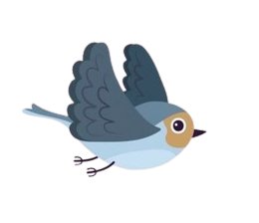
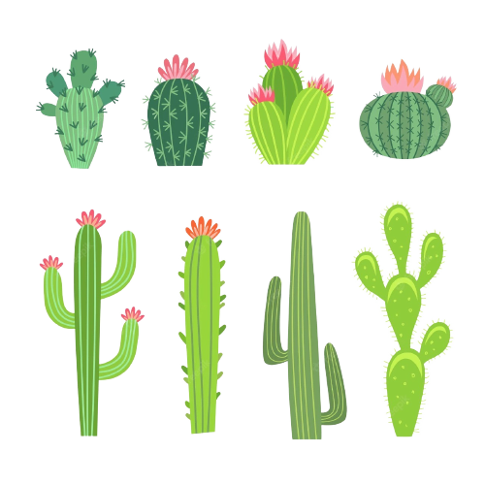
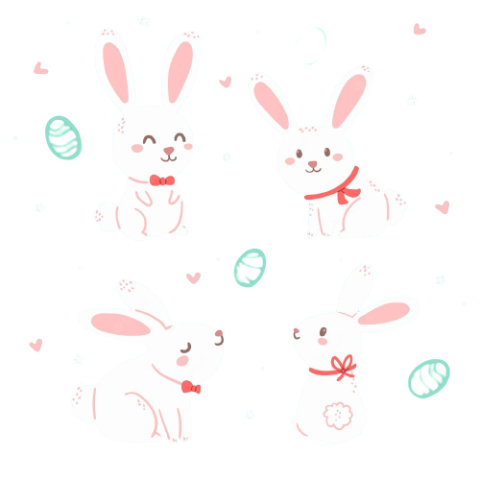
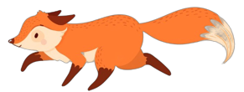
Bunny Jumping
Start Game

Slide 2
Group Members
01
Darmawan Jiddan
02
I Wayan Wahyu Kusuma
2115101013
2115101035
03
Ni Putu Karisma Dewi
2115101059

Slide 3
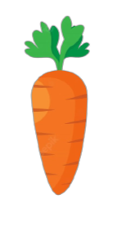
Components
Bunny
Cactus
Carrot
Bird
Wolf

Slide 4

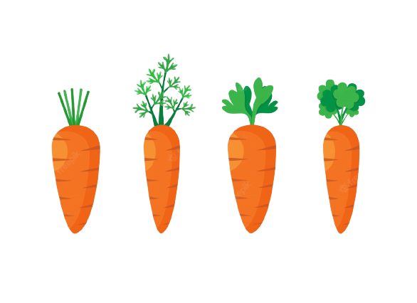
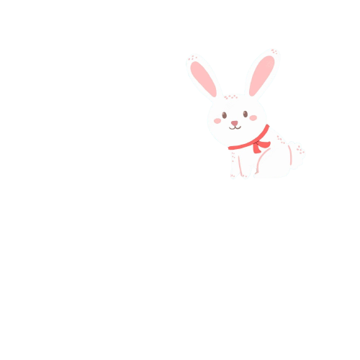
1099
LEVEL ONE
There is only one obstacle in the first level which is a short cactus. When the rabbit collides with the cactus, the rabbit's life will be reduced by one, and the game will stop when the rabbit hits the cactus three times.
There will be an additional score in every level when the rabbit collides with a carrot, and an additional point of 100 points.

Slide 5
2033
LEVEL TWO
There are two obstacles which is short cactus and long cactus.
The bunny will jump higher when there are long cactus. The user will press the up bottom to make the bunny jump

Slide 6
3040
LEVEL THREE
There will be a new obstacle called a bird. The bird will fly on the top of cactus, when the bunny Collison with the bird, it will decrease bunny's life
The rules at the first and second levels are still used at this level and the next level

Slide 7
4011
LEVEL FOUR
There will be a fox that appears randomly. When the fox tries to catch the bunny, the bunny must jump so that the fox can not reach it.

Slide 8
50100
LEVEL FIVE
For the fifth level, there will be no new challenges, but the complexity of the challenges will increase

Slide 9
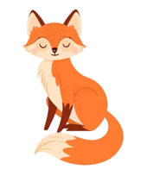
EXCELLENT !!!
Score
50190

Slide 10
Thank You
End Game

